Slide 1
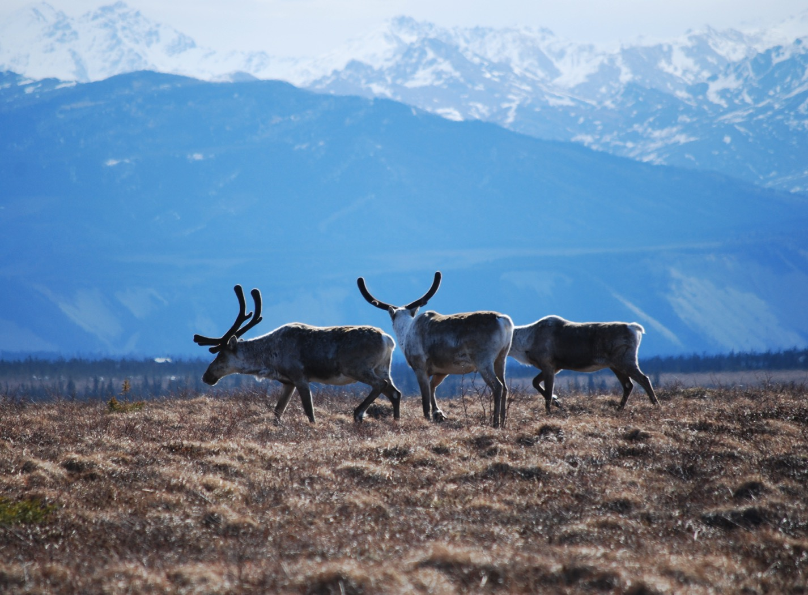
Arctic Boreal Vulnerability Experiment (ABoVE)
2017 ABoVE Airborne Campaign
14 June 2017 (DOY 165)
UAVSAR: Great Slave Lake Region
Charles Miller, Deputy Science Lead
Jet Propulsion Laboratory, California Institute of Technology
and the ABoVE Science Team For Hank Margolis, Eric Kasichke, Bruce Tagg
NASA HQ
2017

Slide 2
14 June 2017/DOY 165 Great Slave Lake Region
Daily Summary:
C-20A (N30502) UAVSAR ABoVE CAMPAIGN (CANADA / ALASKA)
REPORT DATE: 14 June 2017
Current Status of Aircraft: GREEN
Current Status of SAR: GREEN
Current Status of PPA: GREEN
Current Deployment Location: Yellowknife NT (CYZF)
Crew: Asher, Barry, Griffith, Choi, T Miller, Tan
Science Coordinator: N Pinto
Science Lead: M Moghaddam
Project Manager: Y Lou

Slide 3
14 June 2017/DOY 165 Great Slave Lake Region
Daily Summary:
Science Flight – CYZF – CYZF #1 – 5.2 hours
Great flight
Collected 11 of 11 data lines
Hay River, Kakisa Lake, Wrigley, Scotty Creek, Ft. Providence, Snare River, Daring Lake
Flight Plan – 1042v02
Successful overall; radar reset at 80% of line 1; proceeded without repeat.
Last 3 flights have had this same occurrence that the first line has had a radar choke, even though they were different problems. Consider a dummy line for future flights as line #1, to work out such quirks.
Ground team was in the field at Scotty Creek.

Slide 4
14 June 2017/DOY 165 72-Hour Look Ahead
All plans weather dependent
Thursday 15 June 2017 (DOY 166):
Yellowknife – Fairbanks Transit
Friday 16 June 2017 (DOY 167):
Southwest Alaska
Saturday 17 June 2017 (DOY 168):
Yukon-Kuskokwim Delta
Sunday 18 June 2017 (DOY 169):
Hard down day

Slide 5
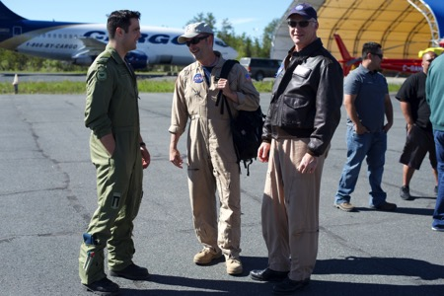
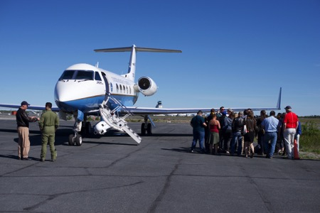
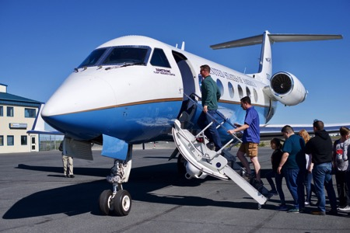
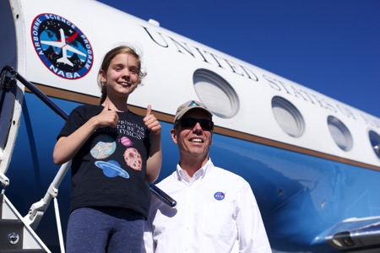
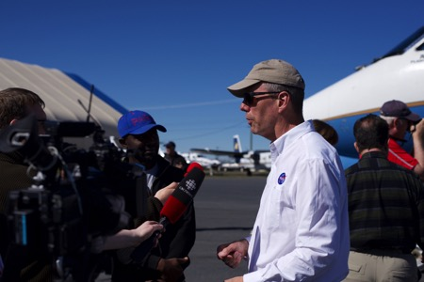
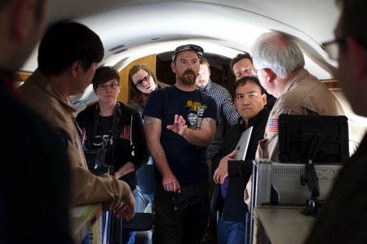
14 June 2017/DOY 165 Great Slave Lake Region
Stevens Village
Beaver
The NASA C-20/UAVSAR team hosted a Public Outreach event
at Yellowknife Airport after the science flight
Kotzebue
Notes:
https://www.youtube.com/watch?v=aPVLyB0Yc6I

Slide 6
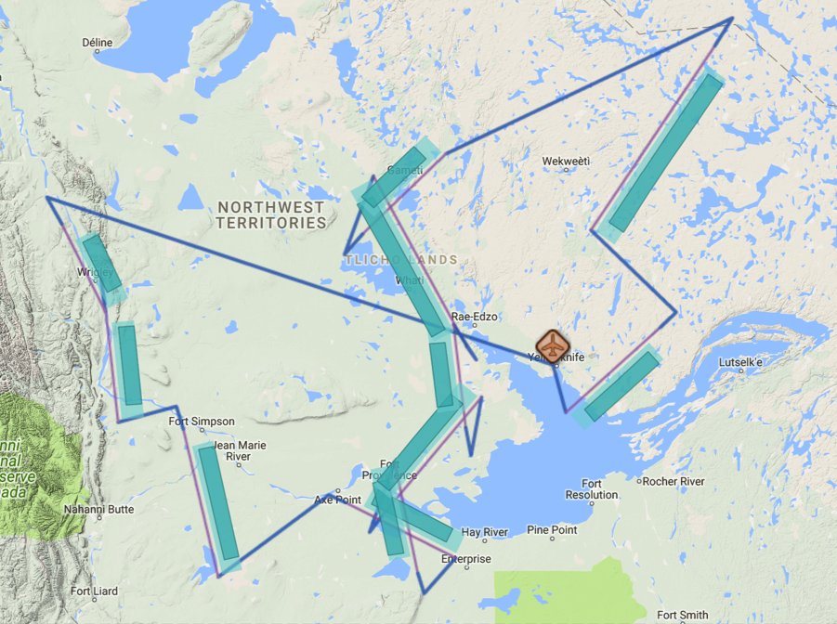
14 June 2017/DOY 165 Great Slave Lake Region
Flight Plan 1142 v02, Report 17063: Yellowknife NT (CYZF) – CYZF
https://uavsar.jpl.nasa.gov/cgi-bin/report.pl?planID=PLAN_17063#flightPlan
Data Acquisitions:
Line 1, ID 15406: Wrigley
Line 2, ID 17402: Fort Simpson
Line 3, ID 16713: Scotty Creek
Line 4, ID 11703: Kakisa Lake 1
Line 5, ID 34809: Kakisa Lake 2
Line 6, ID 04006: Ft Providence
Line 7, ID 35302: Behchoko
Line 8, ID 33102: Snare River
Line 9, ID 04605: Faber Lake
Line 10, ID 21405: Daring Lake
Line 11, ID 22801: Yellowknife
6/14/17 flight plan & acquisition segments
04605
21405
15406
33102
17402
35302
22801
04006
16713
11703
34809

Slide 7
14 June 2017/DOY 165 Great Slave Lake Region
UAVSAR Quick-look products
A. Line 1, ID 15406: Wrigley
B. Line 2, ID 17402: Fort Simpson
C. Line 3, ID 16713: Scotty Creek
Ian Tan, JPL
A
B
C
Notes:
Mackenzie Valley sampling near Wrigley and the Smith Creek flux tower
Mackenzie Valley sampling north of Fort Simpson
Image of the Scotty Creek watershed, flux towers, and several of its 6 km x 6 km Airborne Observing Intensive (AOI) sites

Slide 8
14 June 2017/DOY 165 Great Slave Lake Region
UAVSAR Quick-look products
A. Line 4, ID 11703: Kakisa Lake 1
B. Line 5, ID 34809: Kakisa Lake 2
C. Line 6, ID 04006: Ft Providence
Ian Tan, JPL
A
B
C
Notes:
A. Burn areas near Kakisa Lake
Burn areas near Kakisa Lake
Transect northwest of Fort Providence along the Mackenzie Highway: the red/orange colors show clear evidence of the 2014/2015 fires

Slide 9
14 June 2017/DOY 165 Great Slave Lake Region
UAVSAR Quick-look products
A. Line 7, ID 35302: Behchoko
B. Line 8, ID 33102: Snare River
C. Line 9, ID 04605: Faber Lake
Ian Tan, JPL
A
B
C
Notes:
2014/2015 burn areas near Behchoko show as orange/brown
Snare River watershed imagery will help assess hydroelectric potential of this area to power Yellowknife
Evaluating lake heights for Faber Lake and surrounding ponds is a key goal of the Smith/Pavelsky project

Slide 10
14 June 2017/DOY 165 Great Slave Lake Region
UAVSAR Quick-look products
A. Line 10, ID 21405: Daring Lake
B. Line 11, ID 22801: Yellowknife
Ian Tan, JPL
A
B
Notes:
A. The Daring Lake transect spans the tundra – taiga transition ecotone as well as characterizing vegetation an sol moisture in the tundra around the Daring Lake flux towers
B. Burned areas (reddish) clearly distinguished from unburned areas (light green) on the eastern shore of Great Slave Lake

